Slide 1
GUI BASED SOFTWARE FOR CALCULATING CUTTING PARAMETERS

Slide 2
WHAT IS TURNING PROCESS
CNC Turning is a manufacturing process in which bars of material are held in a chuck and rotated while a tool is fed to the piece to remove material to create the desired shape. A turret with tooling attached is programmed to move to the bar of raw material and remove material to create the programmed result. This is also called “subtraction machining” since it involves material removal. If the center has both tuning and milling capabilities, such as the one above, the rotation can be stopped to allow for milling out of other shapes.

Slide 3
PARAMETERS REQUIRED TO CALCULATE CUTTING SPEED
As, we know for calculating cutting speed the required formula is :
VC = N x N x D/1000
Here, VC is cutting speed(m/min)
N is spindle speed(min^-1)
D is diameter of workpiece(mm)

Slide 4
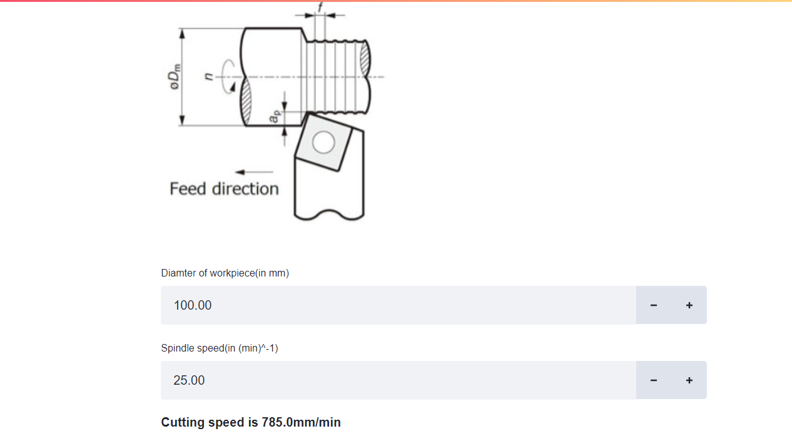
Example solved by using software
Suppose the spindle speed is 25(min^-1) and the diameter of working piece is 100(mm). Calculate the cutting speed.

Slide 5
PARAMETERS REQUIRED TO CALCULATE NET POWER REQUIREMENT
As, we know for calculating net power requirement the required formula is :
PC = VC x F x AP x KC/60000 x N ;
Here, VC is cutting speed (m/min)
N is machine efficiency
F is feed rate(mm/rev)
AP is depth of cut(mm)
KC is specific cutting force (MPa)
PC is net power requirement (kW)

Slide 6
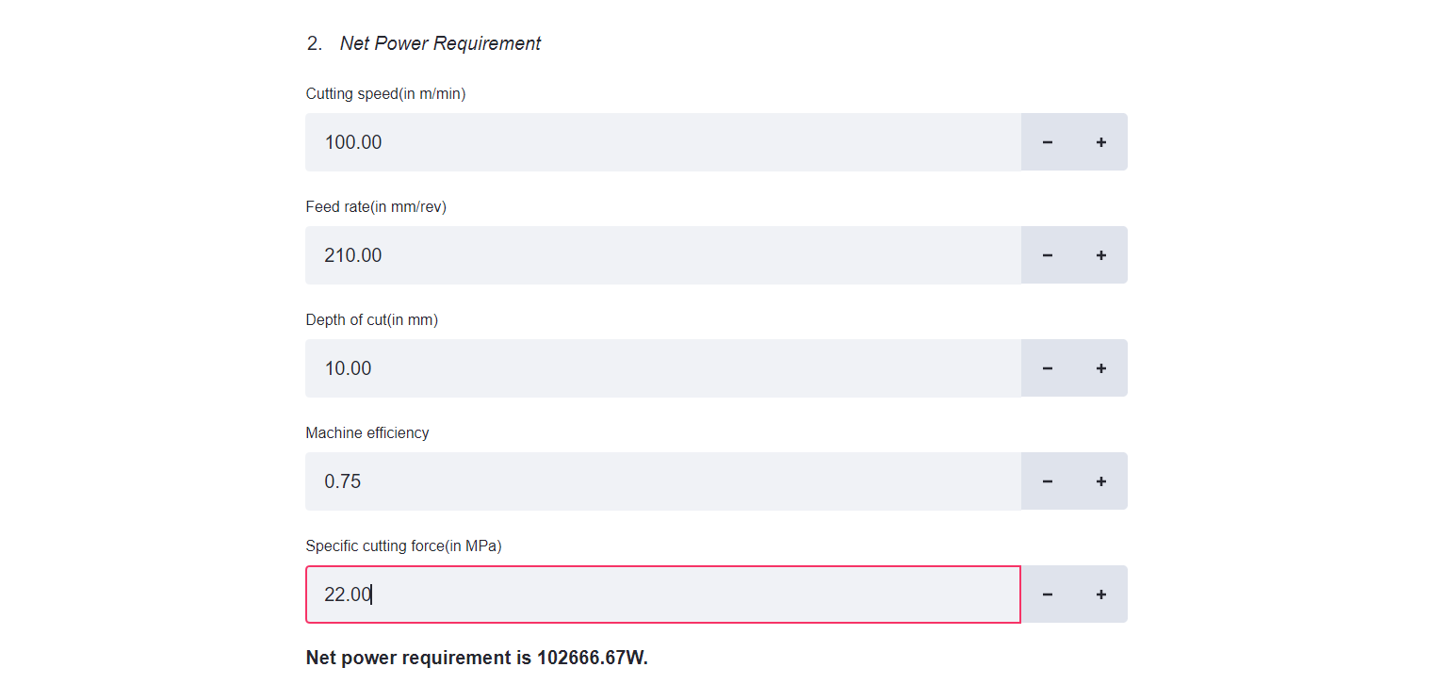
Solved example on net power requirement by using software
Suppose the machine efficiency is 0.75,cutting speed 100(m/min),feed rate is 210(mm/rev),depth of cut is 10mm,specific cutting force 25 MPa. Calculate the net power required.

Slide 7
Parameters required to calculate machined surface roughness
As, we know for calculating machined surface roughness the required formula is :
H = FxFx1000/8xRE;
Here, H is theoretical surface roughness(um)
F is feed rate(mm/rev)
RE is nose radius (mm)

Slide 8
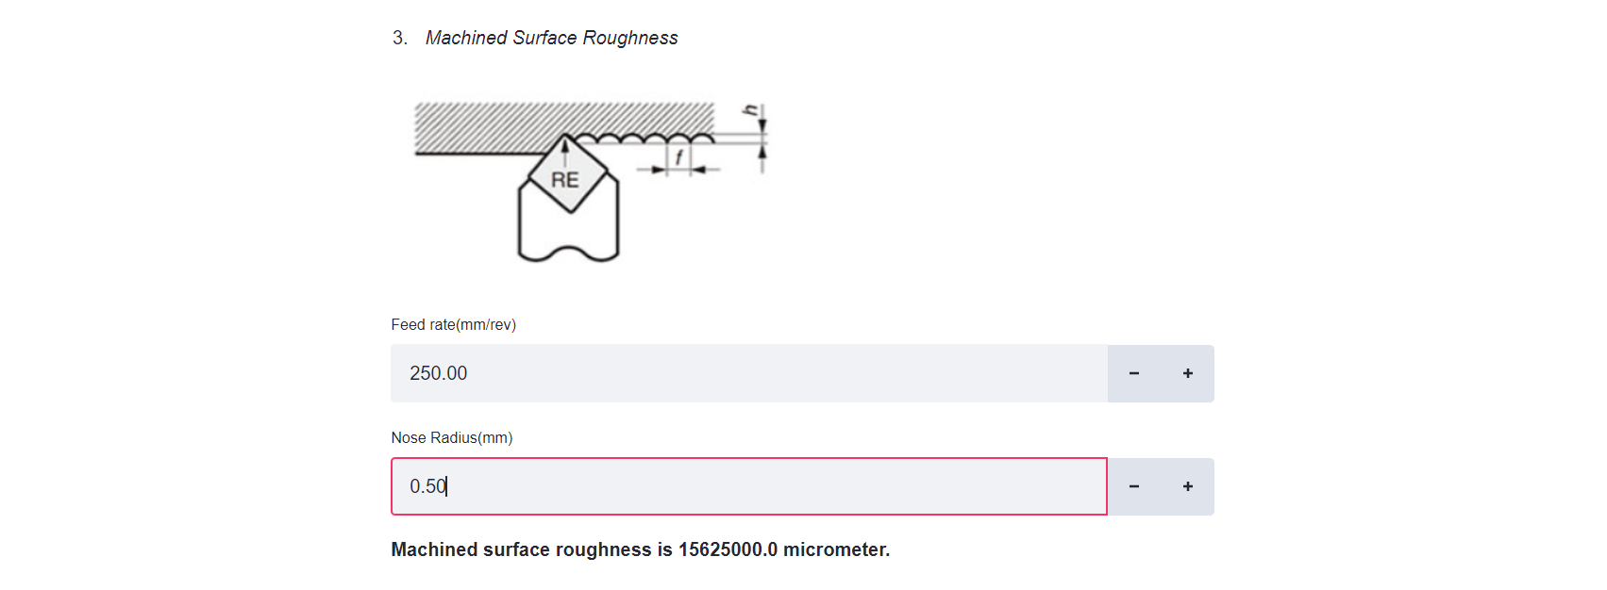
Solved example on machined surface roughness
Suppose that the feed rate is 250 mm/rev and the nose radius is 0.5 mm. Calculate the theoretical surface roughness.

Slide 9
Parameters required to calculate grooving time
As, we know the formula required to calculate the grooving time is:
T = 60 x(D1-D2)/2xFxN ;
Here, T is Machining time (sec）
D1 is Max. diameter of work material in (mm） D2 is Min. diameter of work material in (mm）
F is Feed rate in (mm/rev）
N is Spindle speed in（min⁻¹）

Slide 10

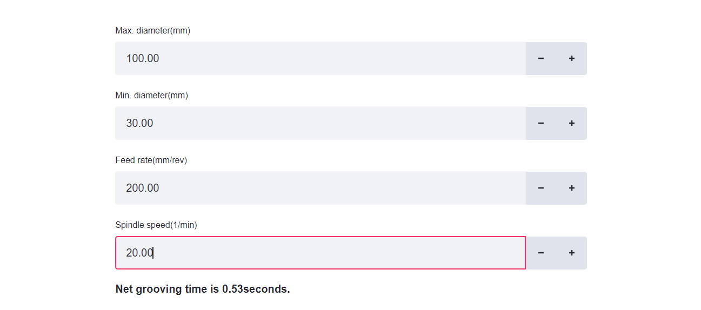
Solved example on calculating grooving time
Suppose that the max and min Diameter of a working material are 100 and 30 mm respectively . Feed rate is 200 mm/rev and spindle speed is 20 min^-1. Calculate the grooving time.

Slide 11
What is milling process
CNC milling is a machining process that utilizes computerized controls to manage the movement and operation of multi-point rotary cutting tools. As the tools rotate and move across the surface of the workpiece, they slowly remove excess material to achieve the desired shape and size.
Milling machines are machine operated cutting tools that are programmed and managed by Computer Numerical Control (CNC) systems to accurately remove materials from a workpiece. The end result of the machining process is a specific part or product that is created using a Computer Aided Design (CAD) software.

Slide 12
Parameters required to calculate rotational speed
The formula required to calculate the rotational speed is:
N = 1000xVC / N x DC;
Here, N is Rotational speed（min⁻¹）
VC is Cutting speed (m/min）
DC is Cutter diameter (mm）

Slide 13

Suppose that the cutting speed is 60 m/min and cutter diameter is 10 mm. Calculate the rotational speed.
Solved example on calculating rotational speed

Slide 14
Parameters required to calculate feed speed
As, we know the formula required to calculate the feed speed is:
VF = F x Z x N / 1000 ;
Here, F: Feed rate per tooth (mm/t）
Z: Number of teeth(pieces)
N: Rotational speed（min⁻¹）
VF: Feed speed per minute (m/min）

Slide 15
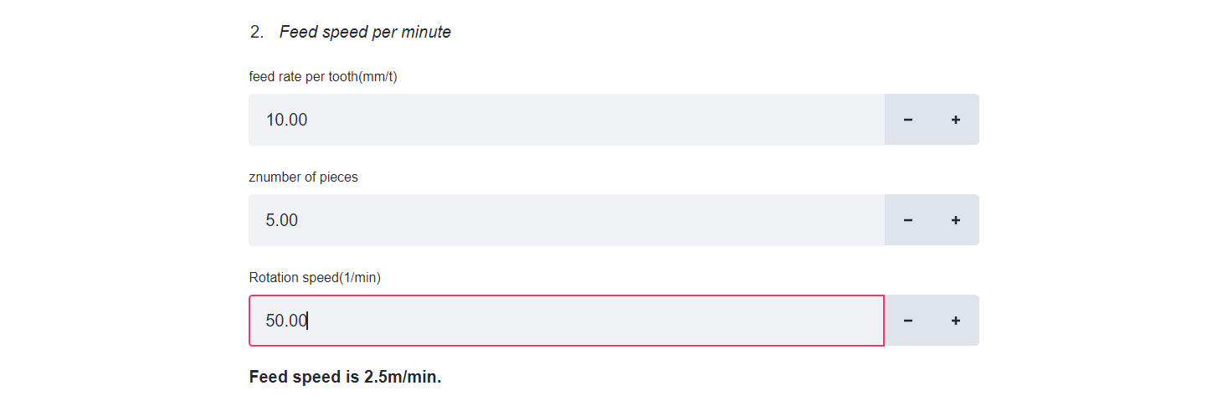
Solved example on calculating feed speed
Suppose that the feed rate per tooth is 10 mm/t ,5 pieces of teeth and the rotational speed is 50 min^-1. Calculate the feed speed.

Slide 16
Parameters required to calculate chip removal amount
As, we know that the formula required to calculate the chip removal amount is:
Q = A x P x VF/1000 ;
Here,
A: Cutting width (mm）
VF: Feed speed per minute (mm/min）
P: Depth of cut (mm）
Q: Chip removal amount (cm³/min）

Slide 17
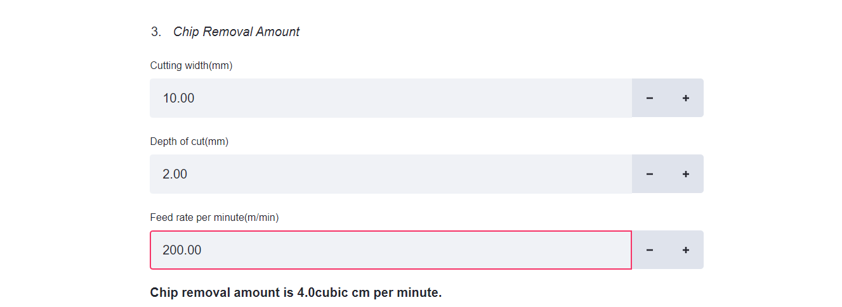
Solved example on calculating chip removal amount
Suppose that the cutting width is 10 mm, depth of cut 2 mm and feed rate is 200 m/min . Calculate the chip removal amount .

Slide 18
Parameters required to calculate net power requirement
As, we know that the formula required to calculate the net power required is :
PC = Q x KC/60000 x N ;
Here,
Q: Chip removal amount（cm³/min)
KC: Specific cutting force (MPa）
N: Machine efficiency
PC: Power requirement (kW）

Slide 19
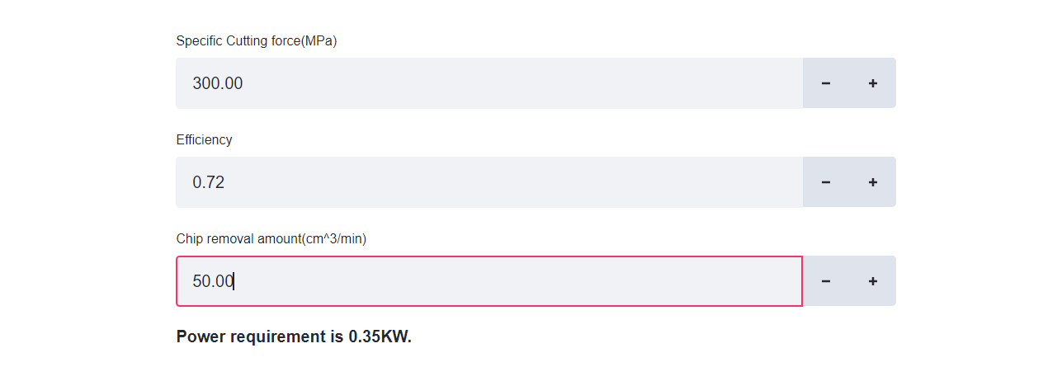
Solved example on calculating power requirement
Suppose that the specific cutting force is 300 MPa, chip removal amount is 50 (cm^3/min) and the efficiency is 0.72. Calculate the power requirement.

Slide 20
Thank You !

